Slide 1
Photo and Picture editing
How can you do this?

Slide 2
Capturing a picture
You can create your own picture.
You can download/capture from the internet
You can get as an attachment from an email
You can download from a device
Get them embedded in an email

Slide 3
Getting pictures from emails and the screen
Use a tool like snipping tool which allows you to capture any part of your visible screen.
PrtScn will take a screen shot of your screen(s) , power button and volume up does the same on the iPhone, the power button and volume down on android
Alt + PrtScn takes a screen shot of the current active app
Pictures embedded in an email – right click and choose ‘Save as Picture’
As an email attachment drag and drop into a folder in file explorer

Slide 4
Creating a picture
First decide what type of picture you want
A simple picture can be created using a number of programs like Paint
To create an icon use a program like icofx
To edit photos use a program like adobe

Slide 5
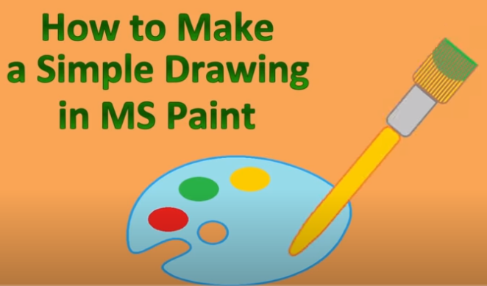
Using MS Paint

Slide 6
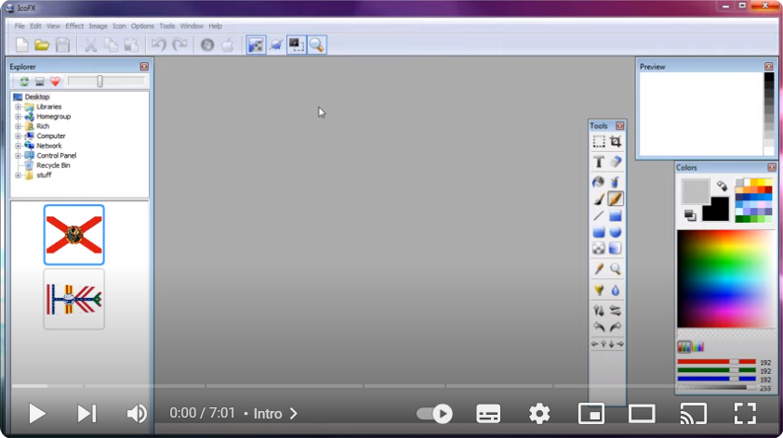
Using icoFx

Slide 7
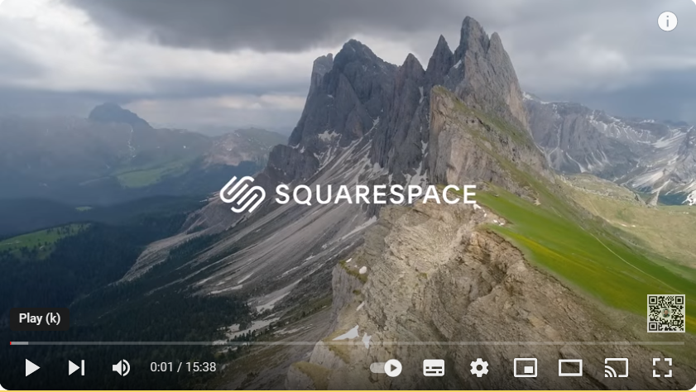
Using Adobe Photo editor

